Slide 1
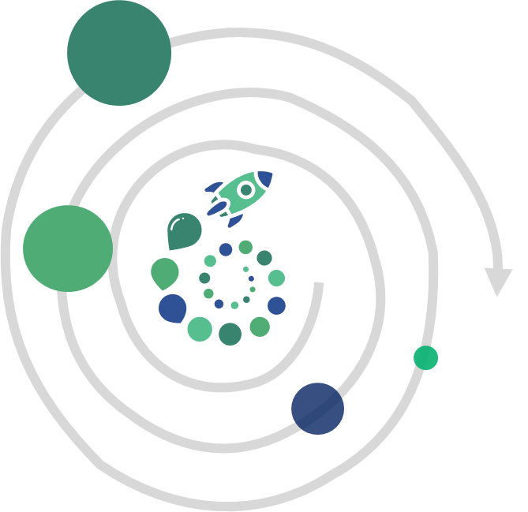
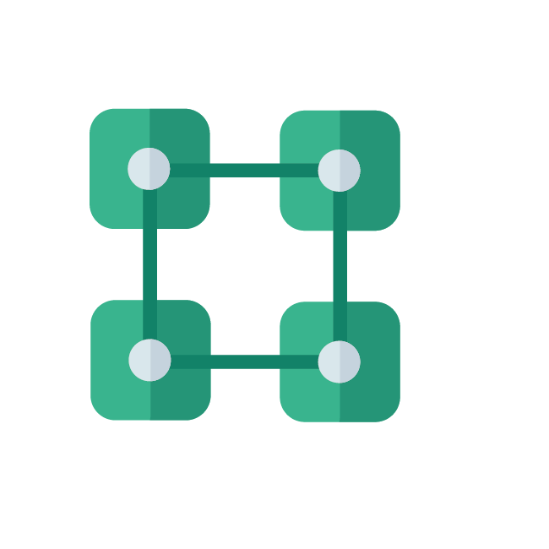

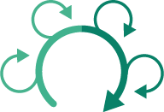
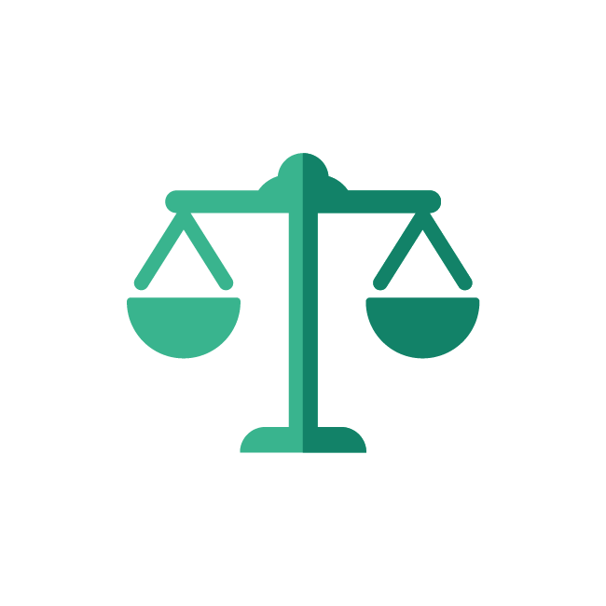
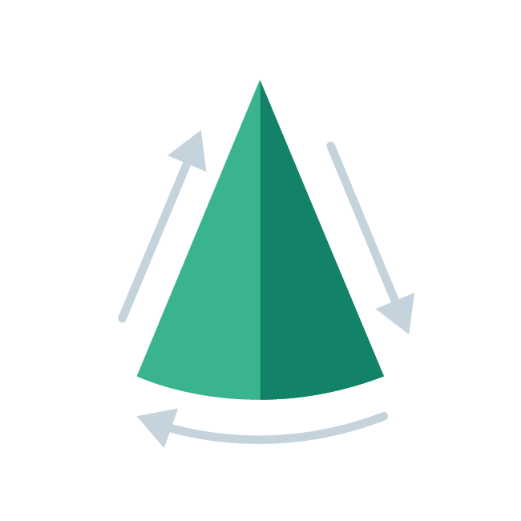
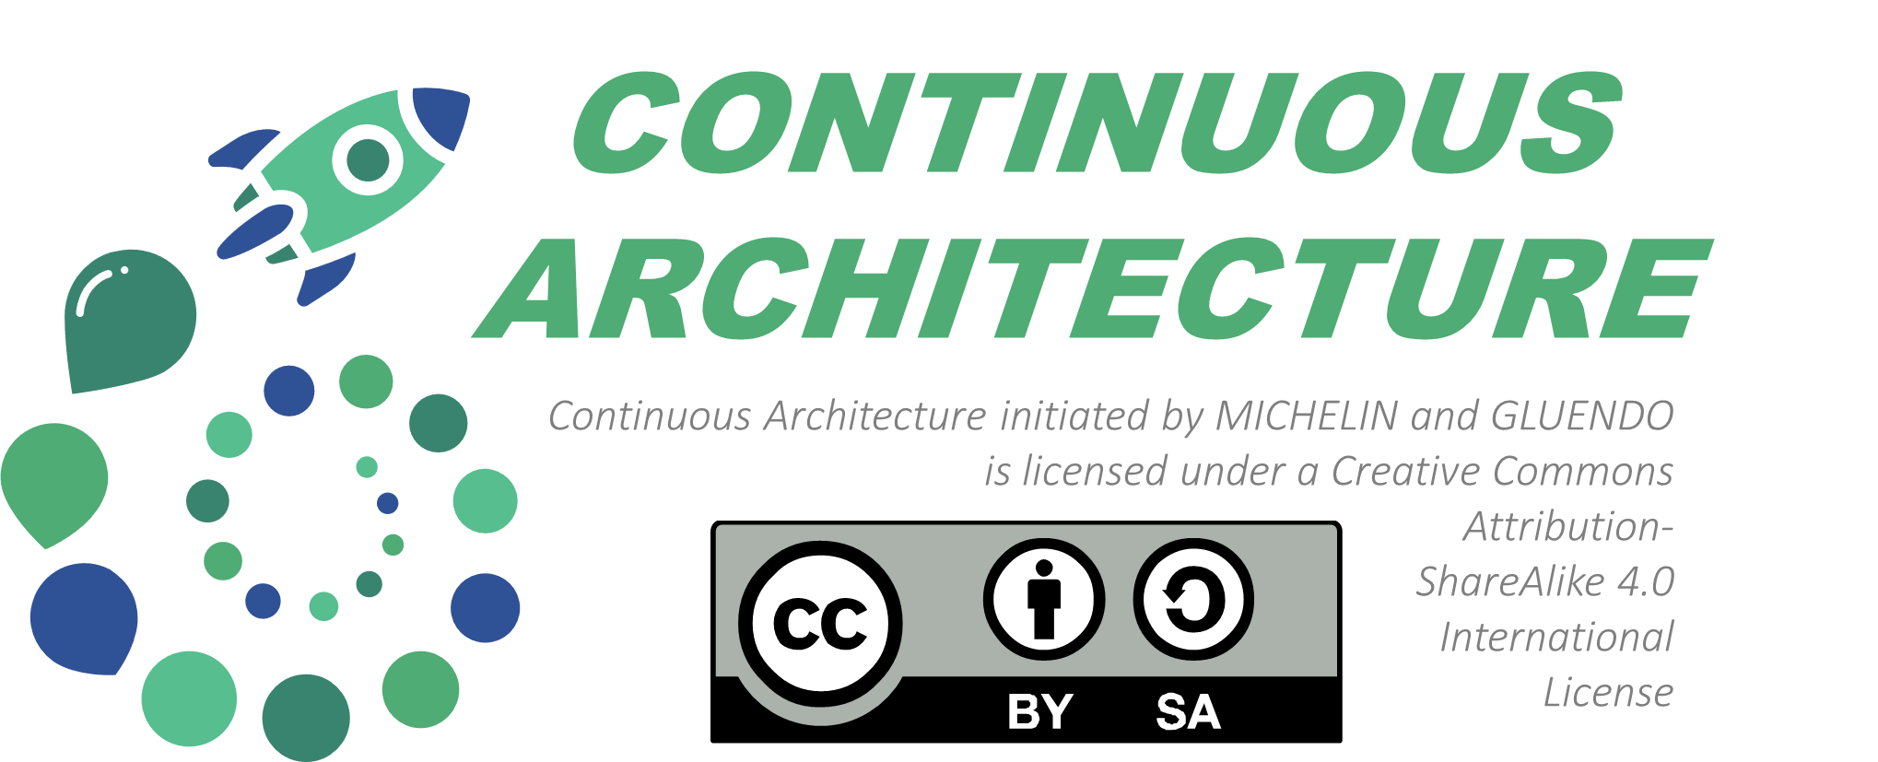
CONNECT
THE DOTS
organise the dialog between intentional architecture and emergent design
CONTINUOUS
DEVELOP
encompass product mindset and agile delivery
people empowerment and architecture skills
(RE)BALANCE
SEE THE WHOLE
between technical
and functional
sustainable and systemic approach
ARCHITECTURAL CHALLENGES
INITIAL DESIGND BY :
Notes:
FRENCH VERSION
Introduire Les 5 défis que C.A cherche à adresser
Expliquer que cela ne résout probablement pas tous les problèmes des uns et des autres.
s’appuyer sur le fait que ce sont les 5 pbs majeurs qui sont ressortie des diagnostiques des années précédente (Move2 95, Evergreen,…) sur ce sujet
ENGLISH VERSION
Introduce the 5 challenges that C.A seeks to address Explain that this probably does not solve everyone's problems. rely on the fact that these are the 5 major points that emerged from the diagnoses of the previous years (Move2 95, Evergreen, ...) on this subject
KEY MESSAGES:
NOT ALL PROBLEM = FOCUS CHOICE
COMES FROM DIAGNOSTICS AND INITIATIVES : MOVE2 95 /EVERGREEN
DETAILLED EXPLANATION
A key think is to organize the dialog and the loop so that continuously, intentional (IT Strategy, roadmap, evergreen ambitions, technical debt plan…) are taking into account by the delivery team and the delivery team takes its part, aliment needs and solutionsprovide feedback to upgadre and influence for the higher level IT MICHELIN capabilities. Roadmap.
An another key think is to consider the whole : not be focus on its area or functional domain to deliver the solution.
All people and team are in away dependent and have consequence , impact on other teams and the whole system business.
All layer, stack can’t be anymore consider individually , full stack is required, especially in a data oriented IS with unexpected used of quantum (component) very technical or functional that could be reused, matched…
An another aspect is about continuity : integration of architecture topics,practices, decisions in agile and product lifecycle.
Need to pave the technical way.
The success of architecture is depending of the technical knowledge and team mastering regarding the old (legacy) and new technology.
But also of the assertivity, decision making, problem solving, mentoring skills of architects and IT team as a whole.

